Slide 1
Databases I
Review

Slide 2
The Basics

Slide 3
Databases
Definition
A database is a shared persistent collection of logically related data supporting several different applications within an organisation.
Shared – used simultaneously by many applications and useres
Persistent i.e. permanently stored
Data stored is all related in some way
Database supports/manages data for several different applications

Slide 4
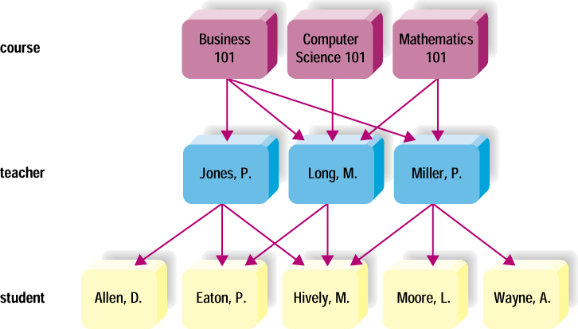
Relational Database
Most flexible
Data stored in tables (physical) or relations
Tables related via a common data item
No predetermined access path
Easy to use – Simple to add to, delete and modify
Notes:
No pre-determined access paths -- Data stored in a collection of columns and rows called a table, or a relation
Tables may be electronically linked via a key field containing common data
Most valuable feature of relational database: simplicity
Easy to add, delete and modify the data
Easy to add to, delete and modify table structures
Common for microcomputers:
Access

Slide 5


Definition of a Relational Database
A relational database is a collection of relations or two-dimensional tables.
When designing a database to store information about employees, you create several tables to store different pieces of information about your employee.
Oracle
server
Table name: EMPLOYEES
Table name: DEPARTMENTS
…
…
Notes:
Definition of a Relational Database
A relational database uses relations or two-dimensional tables to store information.
For example, you might want to store information about all the employees in your company. In a relational database, you create several tables to store different pieces of information about your employees, such as an employee table, a department table, and a salary table.

Slide 6
DBMS
A Database Management System (DBMS) is the set of software which manages a DB or set of DBs
Aims of DBMS
Provides Data Manipulation Languages (languages for storing, retrieving and updating data in the DB).
Provides Data Definition Languages (languages for defining the data).
Efficient, reliable and secure management of large amount of persistent data.
Examples:
Proprietary: MS Access, MS SQL Server, MySQL Enterprise, Oracle
Open source: MySQL Cluster, PostgreSQL

Slide 7
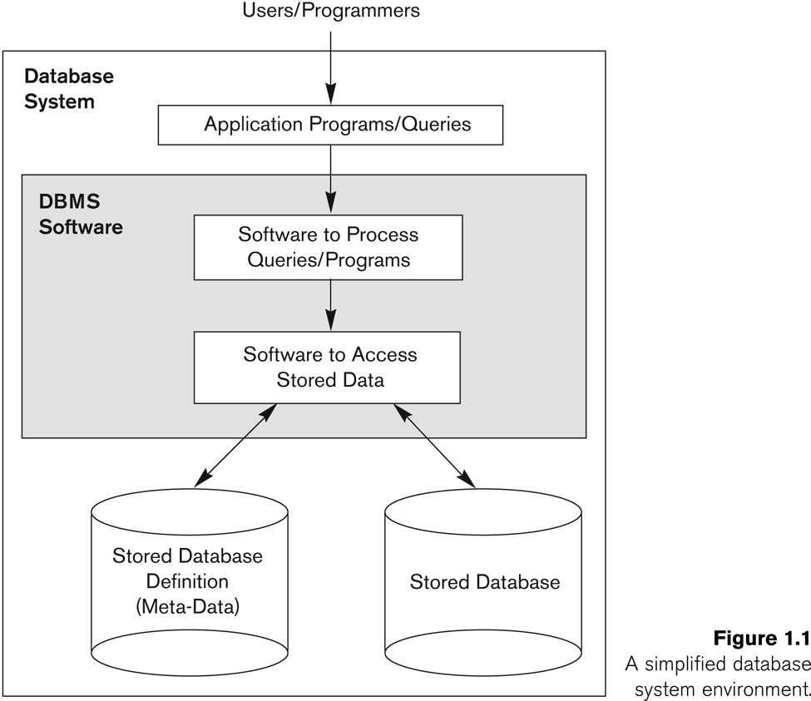
Database System Environment

Slide 8
Issues to bear in mind
Consistency
Protect your database by controlling what can be input into it
Entity integrity – primary keys
Referential integrity – foreign keys
Domain integrity – datatypes and value constraints
Avoid Redundancy
The same piece of data should not be stored in more than one location unless it is there to achieve referential integrity
Why?
If we allow it which piece of data can be considered to be accurate if a difference occurs?

Slide 9
Things to know
Basics
What is a database?
What is a DBMS?
What is a relational database?
What is SQL ? DML and DDL
How to achieve consistency?
Why to avoid redundancy?

Slide 10
Modelling

Slide 11
Database Modeling and Implementation Process
Analysis
Entity Relationship Design
(Logical)
Relational Model
(Logical/ Physical)
Relational DBMS
(Physical)

Slide 12
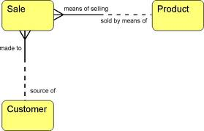
Entity Relationship Model
A detailed, logical representation of the data for an organisation, business area or process

Slide 13
The Entity-Relationship model
Expressed in terms of:
Entities involved (things about which data is to be stored)
Relationships (or associations) among those entities and
Attributes (properties) of both the entities and their relationships
Expressed in a form
Understandable to both the user and to the IT technologist
‘open’ as possible
not tied to any technology or methodology
Flexible enough so that it can be used and understood in practically any environment where information modelled is used

Slide 14
Relationships
A relationship is a link or an association between two entities which is meaningful for the organisation
e.g. A Customer ‘places’ an Order
A relationship is a natural business association that exists between one or more entities
May represent an event
May represent logical affinity
Relationships usually arise because of
association - a Customer ‘places’ an Order
structure - an Order ‘consists’ of Order-Lines
All relationships that are usable only involve two entities
One to one
One to Many
Many to Many
Optional/Required
Notes:
Entities don’t exist in isolation. The things they represent interact with and impact one another to support business mission so we introduce the concept of a relationship

Slide 15
Many:Many
Often with many to many relationships there is data associated with the relationship that cannot be attached sensibly to either entity.
Attaching data to one or other entity results in repeating data (redundancy)
YOU CANNOT HOLD ‘ARRAY’s in a relational table.

Slide 16

Resolving Many:Many
Introduce a Weak Entity
The primary key of a weak entity is always the combination of the primary keys of the entities in the relationship it is resolving
One Fish
One Quango
Quango Members
(Fish, Quango)

Slide 17
Weak Entity
Why is it weak?
It cannot exist independently of its parent tables(Fish and Quango)
Logically/Conceptually it has no purpose
It only exists to facilitate the physical relational model

Slide 18
Identifying v Non-Identifying Relationship
If a relationship exists between two entities
The primary key of one entity becomes an attribute of the other and is a Foreign Key in that entity
If it is part of the primary key it is identifying and the relationship between the two entities is an identifying relationship
If it is not it is non-identifying and the relationship between the two entities is a non-identifying relationship

Slide 19
Difference between Logical and Physical Design
Logical Modelling
Conceptual
Revolves around the needs of the business, not the database, although the needs of the business are used to establish the needs of the database.
Involves gathering information about business processes, business entities (categories of data), and organizational units
It is ok to have many to many relationships

Slide 20
Difference between Logical and Physical Design
Physical
Involves the actual design of a database according to the requirements that were established during logical modelling
Needs to be implementable in the type of database you are working with so we are converting our logical model to a relational data model
Need to resolve the many to many into a series of one to many introducing a weak entity

Slide 21
Things to be able to explain/Be able to do
Logical Modelling – ERD
What is an entity, attribute, relationship?
Cardinality of relationships?
What is an identifying v non-identifying relationship?
Primary key? Foreign key?
Physical Modelling (difference to logical)
How to handle many-to-many relationships?
What is a weak entity?
Be able to identify one or create one and explain why it is needed
Difference between Logical and Physical Model
Relevance to integrity (entity, referential)
Be able to draw a model (quickly)
Using a descriptor similar to that you were given in the lab test and included on past papers and used in lectures
Be able to recognise errors in an ERD

Slide 22
Data Definition Language

Slide 23
Creating a Table
A table is an object that can store data in an Oracle database.
When you create a table, you must specify:
the table name,
the name of each column,
the data type of each column,
and the size of each column
any constraints on the data that each column can contain.
CREATE TABLE [schema.]table
(column datatype [DEFAULT expr][, ...]);

Slide 24
Data Types
Data Type | Description
VARCHAR2(size) | Variable-length character data
CHAR(size) | Fixed-length character data
NUMBER(p,s) | Variable-length numeric data
DATE
LONG | Variable-length character data (up to 2 GB)
CLOB | Character data (up to 4 GB)
RAW and LONG RAW | Raw binary data
BLOB | Binary data (up to 4 GB)
BFILE | Binary data stored in an external file (up to 4 GB)
ROWID | A base-64 number system representing the unique address of a row in its table
Notes:
Data Types
When you identify a column for a table, you need to provide a data type for the column. There are several data types available:

Slide 25
Integrity
Entity Integrity
Primary Keys
Referential Integrity
Foreign Keys
Domain Integrity
Datatype
Value constraints

Slide 26
Constraints
Constraints are rules that the data must follow to get into the table.
Preserve the integrity of the data in the databases.
Data Integrity refers to the validity of data.
Are your data valid? Are your data representing what you have designed them to?
Ensures that no one can insert data that does not conform to your rules
Which ensures that whoever uses your data can be confidence that the data will be consistent.
Constraints enforce rules at the table level.
Constraints prevent the deletion of a table if there are dependencies.

Slide 27
Key Constraints – Primary Key
Enforce entity integrity by uniquely identifying entity instances.
Is an attribute or a set of attributes that uniquely identify a specific instance of an entity.
Every entity in the data model must have a primary key whose values uniquely identify instances of the entity.
To qualify as a primary key for an entity, an attribute must have the following properties:
it must have a non-null value for each instance of the entity
the value must be unique for each instance of an entity
the values must not change or become null during the life of each entity instance.

Slide 28
Composite Key
Sometimes it requires more than one attribute to uniquely identify an entity.
A primary key that made up of more than one attribute is known as a composite key or compound key.
Suppose in a company each instance of the entity Work can be uniquely identified only by a composite key composed of Employee ID and Project ID
Employee ID | Project ID | Hours_Worked
1 | 1 | 200
1 | 2 | 120
2 | 3 | 142
2 | 6 | 24
3 | 5 | 54
3 | 9 | 25

Slide 29
Defining Constraints
You can name a constraint, or allow the Oracle server generates a name by using the SYS_Cn format.
Create a constraint at either of the following times:
At the same time as the table is created
After the table has been created
Define a constraint at the column or table level.
View a constraint in the data dictionary.
Notes:
Constraint Guidelines
All constraints are stored in the data dictionary. Constraints are easy to reference if you give them a meaningful name. Constraint names must follow the standard object-naming rules. If you do not name your constraint, the Oracle server generates a name with the format SYS_Cn, where n is an integer so that the constraint name is unique.
Constraints can be defined at the time of table creation or after the table has been created.
For more information, see “Constraints” in the Oracle Database SQL Reference.

Slide 30
Defining Constraints
Syntax:
Column-level constraint:
Table-level constraint:
CREATE TABLE [schema.]table
(column datatype [DEFAULT expr]
[column_constraint],
...
[table_constraint][,...]);
column [CONSTRAINT constraint_name] constraint_type,
column,...
[CONSTRAINT constraint_name] constraint_type
(column, ...),
Notes:
Defining Constraints
The slide gives the syntax for defining constraints when creating a table. You can create the constraints at either the column level or table level. Constraints defined at the column level are included when the column is defined. Table-level constraints are defined at the end of the table definition and must refer to the column or columns on which the constraint pertains in a set of parentheses.
NOT NULL constraints must be defined at the column level.
Constraints that apply to more than one column must be defined at the table level.
In the syntax:
schema is the same as the owner’s name
table is the name of the table
DEFAULT expr specifies a default value to use if a value is omitted in the INSERT statement
column is the name of the column
datatype is the column’s data type and length
column_constraint is an integrity constraint as part of the column definition
table_constraint is an integrity constraint as part of the table definition

Slide 31
Defining Primary Key
Defining primary key at Column-level:
Defining primary key at Table-level:
CREATE TABLE employees(
employee_id NUMBER(6)
CONSTRAINT emp_emp_id_pk PRIMARY KEY,
first_name VARCHAR2(20),
...);
1
CREATE TABLE employees(
employee_id NUMBER(6),
first_name VARCHAR2(20),
...
job_id VARCHAR2(10) NOT NULL,
CONSTRAINT emp_emp_id_pk
PRIMARY KEY (EMPLOYEE_ID));
2
Notes:
Defining Constraints (continued)
Constraints are usually created at the same time as the table. Constraints can be added to a table after its creation and also temporarily disabled.
Both slide examples create a primary key constraint on the EMPLOYEE_ID column of the EMPLOYEES table.
1. The first example uses the column-level syntax to define the constraint.
2. The second example uses the table-level syntax to define the constraint.
More details about the primary key constraint are provided later in this lesson.

Slide 32
UNIQUE constraint
UNIQUE
This allows the column value to be checked against all other values in that column in the table.
This constraint can be used even if the column allows nulls.
E.g. an e-mail address is not necessary, but if it is present, it must be unique: no other member can have the same e-mail address.

Slide 33
DEFAULT Option
Specify a default value for a column during an insert if no value supplied by a user.
Literal values, expressions, or SQL functions are legal values.
Another column’s name or a pseudocolumn are illegal values.
The default data type must match the column data type.
... hire_date DATE DEFAULT SYSDATE, ...
CREATE TABLE hire_dates (id NUMBER(8),
hire_date DATE DEFAULT SYSDATE);
Table created.
Notes:
DEFAULT Option
When you define a table, you can specify that a column be given a default value by using the DEFAULT option. This option prevents null values from entering the columns if a row is inserted without a value for the column. The default value can be a literal, an expression, or a SQL function (such as SYSDATE or USER), but the value cannot be the name of another column or a pseudocolumn (such as NEXTVAL or CURRVAL). The default expression must match the data type of the column.
Note: CURRVAL and NEXTVAL are explained later in this lesson.

Slide 34
Foreign Key
When one table (A) needs to be related to another table (B), there must be a common attribute(s) in both tables and you need to tell Oracle that Table B is linked to Table A using the common attribute(s).
The common attributes
Will be the primary key in Table A.
Will be a foreign key in Table B.
Where the common field is placed in Table B depends on the type of relationship
If it is identifying it becomes (part of) the primary key of Table B
If it is non-identifying it becomes an attribute of Table B

Slide 35
Foreign Key
The foreign key in a table can then be used access the record in the related table when needed
When data is inserted, deleted, updated or selected from the table
Or changes are made to the data structures if these affect the commonality
Foreign key enforces referential integrity.
A foreign key value must match an existing value in the parent table or be NULL.
Therefore it is not possible to insert invalid data into the foreign key field or delete the data from the primary table if data that depends on it exists in the related table
Foreign keys are based on data values and are purely logical, rather than physical, pointers.

Slide 36
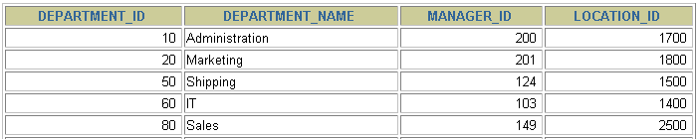
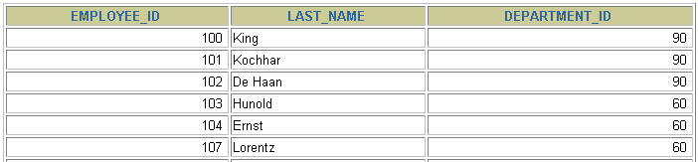
FOREIGN KEY Constraint
DEPARTMENTS
PRIMARY KEY
…
EMPLOYEES
FOREIGN KEY
…
INSERT INTO
Not allowed (9 does not exist)
Allowed
Notes:
FOREIGN KEY Constraint
The FOREIGN KEY (or referential integrity) constraint designates a column or combination of columns as a foreign key and establishes a relationship between a primary key or a unique key in the same table or a different table.
In the example in the slide, DEPARTMENT_ID has been defined as the foreign key in the EMPLOYEES table (dependent or child table); it references the DEPARTMENT_ID column of the DEPARTMENTS table (the referenced or parent table).
Guidelines

Slide 37
Defining Foreign Key
To define a foreign key between Table A and Table B
When creating Table A include the following constraint:
CONSTRAINT <name of constraint> FOREIGN KEY (name of the column(s) in Table A) REFERENCES (name of Table B) (name of column(s) in Table B)

Slide 38
FOREIGN KEY Constraint: Keywords
FOREIGN KEY: Defines the column in the child table at the table-constraint level
REFERENCES: Identifies the table and column in the parent table
ON DELETE CASCADE: Deletes the dependent rows in the child table when a row in the parent table is deleted
ON DELETE SET NULL: Converts dependent foreign key values to null
Notes:
FOREIGN KEY Constraint: Keywords
The foreign key is defined in the child table, and the table containing the referenced column is the parent table. The foreign key is defined using a combination of the following keywords:
FOREIGN KEY is used to define the column in the child table at the table-constraint level.
REFERENCES identifies the table and column in the parent table.
ON DELETE CASCADE indicates that when the row in the parent table is deleted, the dependent rows in the child table are also deleted.
ON DELETE SET NULL converts foreign key values to null when the parent value is removed.
The default behavior is called the restrict rule, which disallows the update or deletion of referenced data.
Without the ON DELETE CASCADE or the ON DELETE SET NULL options, the row in the parent table cannot be deleted if it is referenced in the child table.

Slide 39
ALTER TABLE Statement
Use the ALTER TABLE statement to:
Add a new column
Modify an existing column
Define a default value for the new column
Drop a column
Add a constraint
Drop a constraint
Notes:
ALTER TABLE Statement
After you create a table, you may need to change the table structure for any of the following reasons:
You omitted a column.
Your column definition needs to be changed.
You need to remove columns.
You can do this by using the ALTER TABLE statement. For information about the ALTER TABLE statement, see the Oracle Database 10g SQL Fundamentals II course.

Slide 40
Adding column(s) to a table
To add a column to an existing table:
ALTER TABLE table_name ADD column_name column-definition;
To add multiple columns to an existing table:
ALTER TABLE table_name
ADD (column_1 column-definition,
column_2 column-definition,...
column_n column_definition );

Slide 41
Modifying column(s) in a table
To modify a column in an existing table:
ALTER TABLE table_name MODIFY column_name column_type;
To modify multiple columns in an existing table:
ALTER TABLE table_name MODIFY (column_1 column_type, column_2 column_type,... column_n column_type );

Slide 42
Drop column(s)/Rename column(s) in a table
To drop or remove a column in an existing table:
ALTER TABLE table_name DROP COLUMN column_name;
To rename a column in an existing table:
ALTER TABLE table_name RENAME COLUMN old_name to new_name;

Slide 43
ALTERING constraints
To use ALTER to change constraints, you may:
Add a constraint
Drop a constraint
Enable a constraint
This happens automatically when the constraint is added.
Disable a constraint
May need to do this sometimes to manage inserts/updates without enforcing table order

Slide 44
Altering to add constraints
ALTER TABLE table_name ADD CONSTRAINT constraint_name CHECK (column_name condition);
ALTER TABLE table_name ADD CONSTRAINT constraint_name UNIQUE (column_name condition);
ALTER TABLE table_1 ADD CONSTRAINT constraint_name FOREIGN KEY TBL1_TBL2_FK (column_name_in_table_1)
REFERENCES table_2 (column_name_table_2);

Slide 45
Altering to drop constraints
ALTER TABLE table_name DROP CONSTRAINT constraint_name;

Slide 46
Modifying constraints
Need to DROP and then ADD new constraint

Slide 47
Dropping a Table
All data and structure in the table are deleted.
Any pending transactions are committed.
All indexes are dropped.
All constraints are dropped.
You cannot roll back the DROP TABLE statement.
DROP TABLE dept80;
Table dropped.
Notes:
Dropping a Table
The DROP TABLE statement removes the definition of an Oracle table. When you drop a table, the database loses all the data in the table and all the indexes associated with it.
Syntax
DROP TABLE table
In the syntax, table is the name of the table.
Guidelines
All data is deleted from the table.
Any views and synonyms remain but are invalid.
Any pending transactions are committed.
Only the creator of the table or a user with the DROP ANY TABLE privilege can remove a table.
Note: The DROP TABLE statement, once executed, is irreversible. The Oracle server does not question the action when you issue the DROP TABLE statement. If you own that table or have a high-level privilege, then the table is immediately removed. As with all DDL statements, DROP TABLE is committed automatically.

Slide 48
Things to be able to explain/Be able to do
Create
Drop
Alter
Tables
Constraints
Data types
Know the different ones, when to use them, how to declare them
Know how to declare precision in a number definition
Be able to use all of the above to achieve a specified outcome
Be able to recognise errors in SQL supposed to achieve all the above

Slide 49
Things to be able to explain/Be able to do
Be able to explain what type of data integrity primary key, foreign key and value constraints allow you to achieve
Types of Integrity
Entity integrity
Established with primary key
Referential integrity
Established with foreign key
Domain integrity
Established with datatypes and value constraints (check, null, default values)
Be able to demonstrate your understanding by recognising the type of integrity or being able to develop SQL to implement it

Slide 50
Basic Data Manipulation Language

Slide 51
Inserting data
Need to know
The format of the table
i.e. the columns and their constraints.
You can do either:
A full INSERT
This inserts a value for every column in the table.
A partial INSERT
This inserts some values, but accepts the default values for other columns.
Note:
All CHAR, VARCHAR2 and DATE fields must have their values surrounded by single quotes.
If we do not include a column list then ORACLE assumes you are inserting data in the column order it expects – you may not know what this is.
INSERT INTO table (column1, column2, ... column_n ) VALUES (expression1, expression2, ... expression_n );

Slide 52
Updating and Deleting Existing Table Records
UPDATE:
Updates field values in one or more records in a table
Only one table may be updated at a time
UPDATE tablename SET field1= new_value1, field2 = new_value2, ... WHERE search condition;
DELETE:
Removes specific records from a database table
If search condition is omitted, entire table data is removed
DELETE FROM tablename WHERE search condition;

Slide 53
Updating and Deleting Existing Table Records
TRUNCATE
Removes all of the table data without saving any rollback information
Must disable foreign key constraints before truncating table
TRUNCATE TABLE tablename;

Slide 54
Queries
Queries are the information retrieval requests you make to the database
Your queries are all about the information you are trying to gather (from that stored in the database)
The complexity of your query will depend on the complexity of the fields that the data is housed in, the functionality of the database, and the type of information you are trying to gather.
Queries = Question
Notes:
Queries are the information retrieval requests you make to the database - the way you search through the information. The complexity of your query will depend on the complexity of the fields that the data is housed in, the functionality of the database, and the type of information you are trying to gather.
The queries placed by people using your database can be a guide to, and a reflection of how the data is being used. As the limits of the queries they can run will in large measure be determined by the fields in the database you can see how important it is to consider your data-users’ needs, when designing the database. You need to think about the work of your data users – whether they are researchers, administrators, fundraisers, or lobbyists. The work they do with the information will affect the way they need to process it and the form in which they need to receive it.
Ask yourself:
What sorts of data comparisons will they want to make? Historical, regional, institutional?
What methods of sorting/ordering will they need?
How will they want results presented?
What search choices will they need?
Answering these questions involves understanding how they work with information. The answers to these questions must inform your database planning work.

Slide 55
How does it work?
The SELECT statement is a Query
For each Query the DBMS
Creates a temporary table
Its structure is the set of columns you have indicated
It populates it with values from the columns in the tables you indicated
If you have a where clause, it only inserts data that matches the condition you specify
If you run the SELECT as a single statement
Your output will be in the form of a table
If you run it as a Script
Your output will look like a report

Slide 56
Reports
If the query is a question...
...then the report is its answer
In the form of a table
(temporary only for the duration of the query)
Includes specified columns and rows only
Original table left completely untouched
Reports can be tailored to the needs of the data-user, making the information they extract much more useful
For example:
An alphabetical list of students enrolled on a module
A sheet of mailing labels for students sorted by county

Slide 57
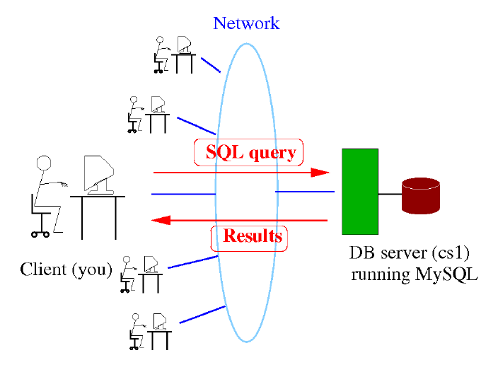
SQL
Database server: machine that runs DBMS (e.g. Oracle)provides database “service” to clients
Clients may interact directly with DBMS
1 Client connects to DBMS (logs in)
2 Client types SQL query and submits
3 DBMS executes query and returns results to client
4 Repeat (2,3) at will; disconnect when done
DB SERVER

Slide 58
Character Strings and Dates
Character strings and date values are enclosed by single quotation marks.
Character values are case-sensitive,
Date values are format-sensitive.
The default date format is DD-MON-RR.
SELECT movie_price
FROM mm_movie
WHERE movie_title = 'Jaws' ;

Slide 59
Comparison Conditions
Operator | Meaning
= | Equal to
> | Greater than
>= | Greater than or equal to
< | Less than
<= | Less than or equal to
<> | Not equal to
BETWEEN ...AND... | Between two values (inclusive)
IN(set) | Match any of a list of values
LIKE | Match a character pattern
IS NULL | Is a null value
Notes:
Comparison Conditions
Comparison conditions are used in conditions that compare one expression to another value or expression. They are used in the WHERE clause in the following format:
Syntax
... WHERE expr operator value
Example
... WHERE hire_date = '01-JAN-95'
... WHERE salary >= 6000
... WHERE last_name = 'Smith'
An alias cannot be used in the WHERE clause.
Note: The symbols != and ^= can also represent the not equal to condition.

Slide 60
Logical Conditions
Operator | Meaning
AND | Returns TRUE if both component conditions are true
OR | Returns TRUE if either component condition is true
NOT | Returns TRUE if the following condition is false
Notes:
Logical Conditions
A logical condition combines the result of two component conditions to produce a single result based on those conditions, or it inverts the result of a single condition. A row is returned only if the overall result of the condition is true.
Three logical operators are available in SQL:
AND
OR
NOT
All the examples so far have specified only one condition in the WHERE clause. You can use several conditions in one WHERE clause using the AND and OR operators.

Slide 61
Rules of Precedence
Operator | Meaning
1 | Arithmetic operators
2 | Concatenation operator
3 | Comparison conditions
4 | IS [NOT] NULL, LIKE, [NOT] IN
5 | [NOT] BETWEEN
6 | Not equal to
7 | NOT logical condition
8 | AND logical condition
9 | OR logical condition
You can use parentheses to override rules of precedence.
Notes:
Rules of Precedence
The rules of precedence determine the order in which expressions are evaluated and calculated. The table lists the default order of precedence. You can override the default order by using parentheses around the expressions that you want to calculate first.

Slide 62

Using the NULL Conditions
Test for nulls with the IS NULL operator.
SELECT firstname, lastname
FROM mm_customer
WHERE on_mailing_list IS NULL ;
Notes:
Using the NULL Conditions
The NULL conditions include the IS NULL condition and the IS NOT NULL condition.
The IS NULL condition tests for nulls. A null value means the value is unavailable, unassigned, unknown, or inapplicable. Therefore, you cannot test with = because a null cannot be equal or unequal to any value.
…

Slide 63
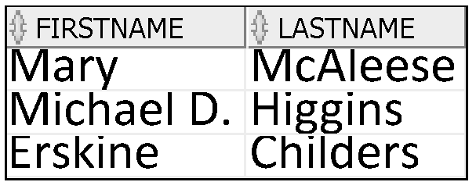
Using the NULL Conditions
Test for non null values with the IS NOT NULL operator.
SELECT firstname, lastname
FROM mm_customer
WHERE on_mailing_list IS NOT NULL ;
Notes:
Using the NULL Conditions
The NULL conditions include the IS NULL condition and the IS NOT NULL condition.
The IS NULL condition tests for nulls. A null value means the value is unavailable, unassigned, unknown, or inapplicable. Therefore, you cannot test with = because a null cannot be equal or unequal to any value.
…

Slide 64
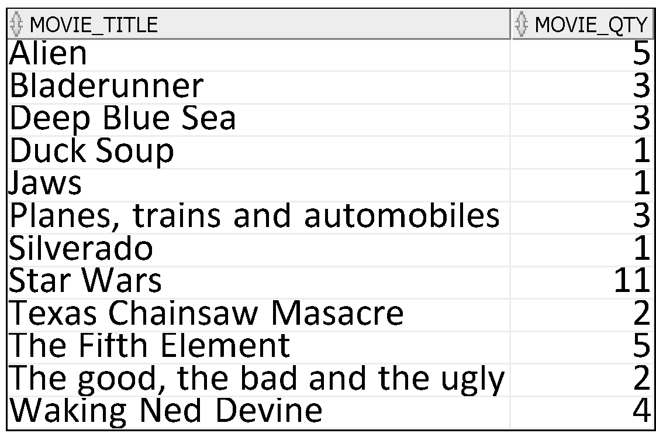
ORDER BY Clause
Sort retrieved rows with the ORDER BY clause:
ASC: ascending order, default
DESC: descending order
The ORDER BY clause comes last in the SELECT statement:
SELECT movie_title, movie_qty from mm_movie ORDER BY movie_title ASC;

Slide 65
Things to be able to explain/Be able to do
Insert
Update
Delete
SELECT statement
Projection – filtering out unwanted columns.
Renaming – using alternate titles
Condition – Boolean operators
Restriction – filtering out unwanted rows
Sorting
Recognise errors in DML statements and correct
Be able to use all the above
Be able to explain how they work
Be able to recognise how output was created and generate SQL to achieve the output

Slide 66
More Advanced Data Manipulation

Slide 67
SQL Functions
Input
Output
Function
arg 1
Function performs action
arg 2
Result
value
arg n
Notes:
SQL Functions
Note:

Slide 68
Two Types of SQL Functions
Functions
Single-row
functions
Multiple-row
functions
Return one result
per row
Return one result
per set of rows
Notes:
SQL Functions (continued)
There are two types of functions:
Single-row functions
Multiple-row functions
Single-Row Functions
These functions operate on single rows only and return one result per row. There are different types of single-row functions. This lesson covers the following ones:
Character
Number
Date
Conversion
General
Multiple-Row Functions
Functions can manipulate groups of rows to give one result per group of rows. These functions are also known as group functions (covered in a later lesson).
Note: For more information and a complete list of available functions and their syntax, see Oracle SQL Reference.

Slide 69
SQL Functions
Single-Row Functions
Acts on each row
Can accept multiple arguments
Column name
Variable name
Expression
Constant
Returns a single value for each row

Slide 70
Single-Row Functions
Character
Accept character input
Can return both character and numeric values
NVL
NVL2
NULLIF
COALESCE
CASE
DECODE
General
Single-row
functions
Number
Accepts numeric input
And returns numeric values
\
Conversion
Date
Convert a value from one data type to another
Operate on date data type
Returns a value of date data type
Notes:
Single-Row Functions (continued)
This lesson covers the following single-row functions:
Character functions: Αccept character input and can return both character and number values
Number functions: Accept numeric input and return numeric values
Date functions: Operate on values of the DATE data type (All date functions return a value of DATE data type except the MONTHS_BETWEEN function, which returns a number.)
Conversion functions: Convert a value from one data type to another
General functions:
NVL
NVL2
NULLIF
COALESCE
CASE
DECODE

Slide 71



Using a Subquery to Solve a Problem
Which movies have a value greater than Jaws?
Main query:
Which movies have a value greater than Jaws?
Subquery:
What is the value of Jaws?
Notes:
Using a Subquery to Solve a Problem
Suppose you want to write a query to find out who earns a salary greater than Abel’s salary.
To solve this problem, you need two queries: one to find how much Abel earns, and a second query to find who earns more than that amount.
You can solve this problem by combining the two queries, placing one query inside the other query.
The inner query (or subquery) returns a value that is used by the outer query (or main query). Using a subquery is equivalent to performing two sequential queries and using the result of the first query as the search value in the second query.

Slide 72
Subquery Syntax
The subquery (inner query) executes once before the main query (outer query).
The result of the subquery is used by the main query.
SELECT select_list
FROM table
WHERE expr operator
(SELECT select_list
FROM table);
Notes:
Subquery Syntax
A subquery is a SELECT statement that is embedded in a clause of another SELECT statement. You can build powerful statements out of simple ones by using subqueries. They can be very useful when you need to select rows from a table with a condition that depends on the data in the table itself.
You can place the subquery in a number of SQL clauses, including the following:
WHERE clause
HAVING clause
FROM clause
In the syntax:
operator includes a comparison condition such as >, =, or IN
Note: Comparison conditions fall into two classes: single-row operators (>, =, >=, <, <>, <=) and multiple-row operators (IN, ANY, ALL).
The subquery is often referred to as a nested SELECT, sub-SELECT, or inner SELECT statement. The subquery generally executes first, and its output is used to complete the query condition for the main (or outer) query.

Slide 73
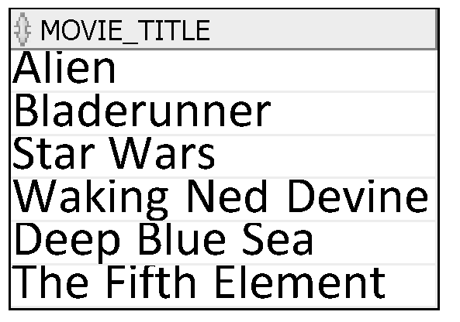
Using a Subquery
SELECT movie_title
FROM mm_movie
WHERE movie_price >
(SELECT movie price
FROM mm_movie
WHERE movie_title = 'Jaws');
7
Notes:
Using a Subquery
The outer query takes the result of the inner query and uses this result to display all the movies with a value greater than that amount.

Slide 74
Multiple-Row Subqueries
Return more than one row
Use multiple-row comparison operators
Operator | Meaning
IN | Equal to any member in the list
ANY | Compare value to each value returned by the subquery
ALL | Compare value to every value returned by the subquery
Notes:
Multiple-Row Subqueries
Subqueries that return more than one row are called multiple-row subqueries. You use a multiple-row operator, instead of a single-row operator, with a multiple-row subquery. The multiple-row operator expects one or more values:
SELECT last_name, salary, department_id
FROM employees
WHERE salary IN (SELECT MIN(salary)
FROM employees
GROUP BY department_id);
Example
Find the employees who earn the same salary as the minimum salary for each department.
The inner query is executed first, producing a query result. The main query block is then processed and uses the values that were returned by the inner query to complete its search condition. In fact, the main query appears to the Oracle server as follows:
SELECT last_name, salary, department_id
FROM employees
WHERE salary IN (2500, 4200, 4400, 6000, 7000, 8300, 8600, 17000);

Slide 75
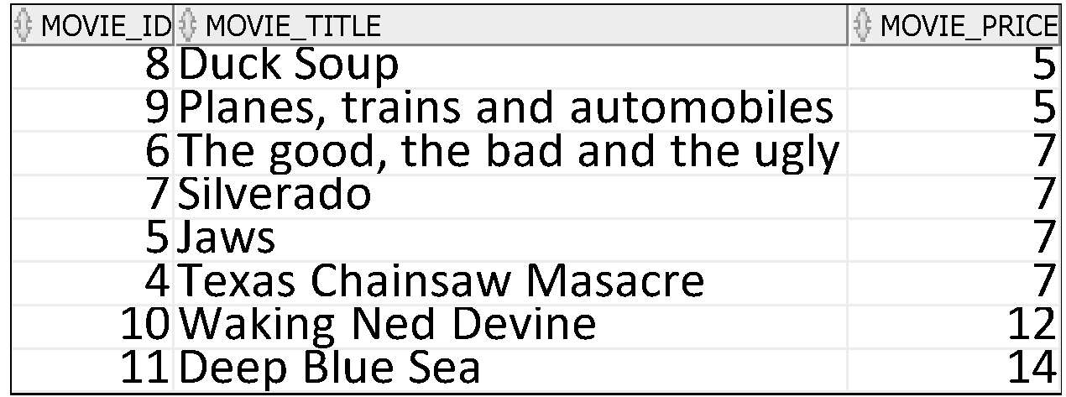
Using the ANY Operator in Multiple-Row Subqueries
SELECT movie_id, movie_title, movie_price
FROM mm_movie
WHERE movie_price < ANY
(SELECT movie_price
FROM mm_movie
WHERE movie_type_id=1)
AND movie_type_id <> 1;
10,8,15
Notes:
Multiple-Row Subqueries (continued)
The ANY operator (and its synonym, the SOME operator) compares a value to each value returned by a subquery. The slide example displays employees who are not IT programmers and whose salary is less than that of any IT programmer. The maximum salary that a programmer earns is $9,000.
<ANY means less than the maximum. >ANY means more than the minimum. =ANY is equivalent to IN.

Slide 76
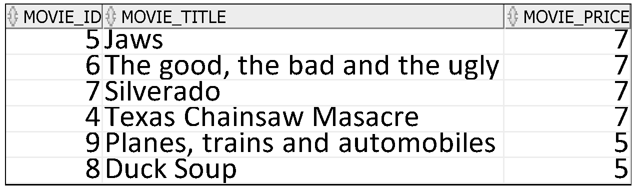
Using the ALL Operator in Multiple-Row Subqueries
SELECT movie_id, movie_title, movie_price
FROM mm_movie
WHERE movie_price < ALL
(SELECT movie_price
FROM mm_movie
WHERE movie_type_id=1)
AND movie_type_id <> 1;
10,8,15
Notes:
Multiple-Row Subqueries (continued)
The ALL operator compares a value to every value returned by a subquery. The slide example displays employees whose salary is less than the salary of all employees with a job ID of IT_PROG and whose job is not IT_PROG.
>ALL means more than the maximum, and <ALL means less than the minimum.
The NOT operator can be used with IN, ANY, and ALL operators.

Slide 77
Guidelines for Using Subqueries
Enclose subqueries in parentheses.
(…..)
Place subqueries on the right side of the comparison condition.
Use single-row operators with single-row subqueries, and use multiple-row operators with multiple-row subqueries.
Notes:
Guidelines for Using Subqueries
A subquery must be enclosed in parentheses.
Place the subquery on the right side of the comparison condition for readability.
With Oracle8i and later releases, an ORDER BY clause can be used and is required in the subquery to perform Top-N analysis.
Prior to Oracle8i, however, subqueries could not contain an ORDER BY clause. Only one ORDER BY clause could be used for a SELECT statement; if specified, it had to be the last clause in the main SELECT statement.
Two classes of comparison conditions are used in subqueries: single-row operators and multiple-row operators.

Slide 78
UPDATE using a sub-query
Suppose we want to increase the price of all movies in the horror movie_type by 10%.
UPDATE MM_MOVIE
SET MOVIE_Price = 1.1 * MOVIE_PRICE
WHERE MOVIE_TYPE_ID IN (
SELECT MOVIE_TYPE_ID
FROM MM_MOVIE_TYPE
WHERE UPPER(MOVIE_TYPE_DESCRIPTION)='HORROR');

Slide 79
UPDATE using a sub-query
Suppose we want to set the price of movies with IDs of 1, 2, 3, 4 to be the same as the price of movie 10?
UPDATE MM_MOVIE
SET MOVIE_Price = (SELECT MOVIE_PRICE FROM MM_MOVIE WHERE MOVIE_ID=10)
WHERE MOVIE_ID BETWEEN 1 AND 4;

Slide 80
DELETE using a sub-query
DELETE FROM MM_RENTAL
WHERE MOVIE_ID IN
(SELECT MOVIE_ID
FROM MM_MOVIE
WHERE MOVIE_TYPE_ID IN
(SELECT MOVIE_TYPE_ID
FROM MM_MOVIE_TYPE
WHERE UPPER(MOVIE_TYPE_DESCRIPTION)='HORROR')
);

Slide 81
Things to be able to explain/be able to do
Functions/conditional expressions
Be able to use functions/conditional expression
Be able to recognise when a function/conditional expression has been applied when provided with output
Sub-queries
Be able to explain what a sub-query does, when you can use one
Be able to use one to select, insert, update, delete

Slide 82
Joins

Slide 83
INNER Versus OUTER Joins
Inner Join
the join of two tables returning only matched rows is called an inner join.
Outer join
A join between two tables that returns the results of the inner join as well as the unmatched rows from the left (or right) tables is called a left (or right) outer join.
A join between two tables that returns the results of an inner join as well as the results of a left and right join is a full outer join.
Notes:
INNER Versus OUTER Joins
Joining tables with the NATURAL JOIN, USING, or ON clauses results in an inner join. Any unmatched rows are not displayed in the output. To return the unmatched rows, you can use an outer join. An outer join returns all rows that satisfy the join condition and also returns some or all of those rows from one table for which no rows from the other table satisfy the join condition.
There are three types of outer joins:
LEFT OUTER
RIGHT OUTER
FULL OUTER

Slide 84
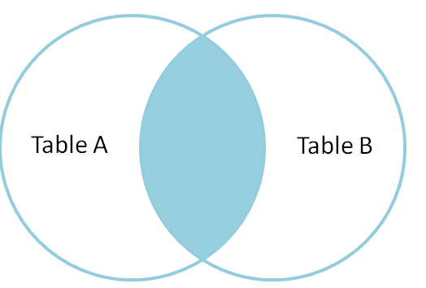
Inner Join
Return the set of records that match in both Table A and Table B
Can be natural, equi or non-equi join.
Difference is the columns you use to join and conditions you place on the join.
Equi joins depend on referential integrity (even if columns named differently) and equality
Non-Equi joins don’t.

Slide 85
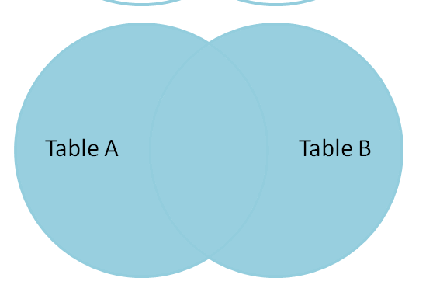
Full Outer Join
Return the set of all records in Table A and Table B, with matching records from both sides where available.
If there is no match, the columns from the missing side will be returned as null.
Can exclude the records we don't want from both sides via a where clause.

Slide 86
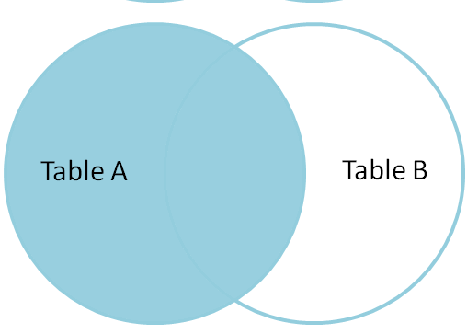
Left Outer Join
Return the set of records from Table A, with the matching records (where available) in Table B.
If there is no match, the columns from the right side will contain null.
Can exclude the records we don't want from the right side via a where clause.

Slide 87
Right Outer Join
Return the set of records from Table B, with the matching records (where available) in Table A.
If there is no match, the columns from the left side will contain null.
Table A
Table B
Can exclude the records we don't want from the right side via a where clause.

Slide 88
Natural Join
“NATURAL” means equi-join for each pair of attributes with the same name
You don’t specify, will match on all columns which have the same name
While this might seem to be easy, usually we want to be in control of the linking of tables in a query so this is rarely used.

Slide 89
Things to be able to explain/Be able to do
Inner join
Equi, non-equi, natural
Outer
Left, right, full
What are the differences?
Be able to explain
Be able to build SQL to use inner/outer joins
Be able to recognise when one has been used

Slide 90
Groups

Slide 91
Types of Group Functions
AVG
COUNT
MAX
MIN
STDDEV
SUM
Group
functions
Notes:
Types of Group Functions
Each of the functions accepts an argument. The following table identifies the options that you can use in the syntax:

Slide 92
Group Functions: Syntax
SELECT [column,] group_function(column), ...
FROM table
[WHERE condition]
[GROUP BY column]
[ORDER BY column];
Use the DISTINCT keyword to make the function consider only nonduplicate values;
ALL makes it consider every value, including duplicates. The default is ALL and therefore does not need to be specified.
The data types for the functions with an expr argument may be CHAR, VARCHAR2, NUMBER, or DATE.
Notes:
Guidelines for Using Group Functions
DISTINCT makes the function consider only nonduplicate values; ALL makes it consider every value, including duplicates. The default is ALL and therefore does not need to be specified.
The data types for the functions with an expr argument may be CHAR, VARCHAR2, NUMBER, or DATE.
All group functions ignore null values. To substitute a value for null values, use the NVL, NVL2, or COALESCE functions.

Slide 93

Using the DISTINCT Keyword
COUNT(DISTINCT expr) returns the number of distinct non-null values of the expr.
To display the number of distinct categories in the MM_MOVIE table:
SELECT COUNT(DISTINCT movie_type_id)
FROM mm_movie;
This as you would expect returns 5 – there is at least one movie of each type in the movie table and there are 5 categories in the movie_type table
Notes:
DISTINCT Keyword
Use the DISTINCT keyword to suppress the counting of any duplicate values in a column.

Slide 94

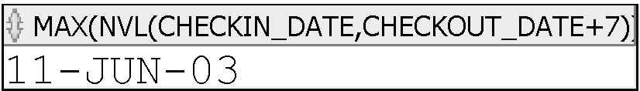
Group Functions and Null Values
Group functions ignore null values in the column:
The NVL function forces group functions to include null values:
1
SELECT MAX(CHECKIN_DATE)
FROM MM_RENTAL;
SELECT MAX(NVL(CHECKIN_DATE,checkout_date+7))
FROM MM_RENTAL;
2
Notes:
Group Functions and Null Values
All group functions ignore null values in the column.
The NVL function forces group functions to include null values.

Slide 95
Creating Groups of Data: GROUP BY Clause Syntax
You can divide rows in a table into smaller groups by using the GROUP BY clause.
SELECT column, group_function(column)
FROM table
[WHERE condition]
[GROUP BY group_by_expression]
[ORDER BY column];
Notes:
GROUP BY Clause
You can use the GROUP BY clause to divide the rows in a table into groups. You can then use the group functions to return summary information for each group.
In the syntax:
group_by_expression specifies columns whose values determine the basis for grouping rows
Guidelines
If you include a group function in a SELECT clause, you cannot select individual results as well, unless the individual column appears in the GROUP BY clause. You receive an error message if you fail to include the column list in the GROUP BY clause.
Using a WHERE clause, you can exclude rows before dividing them into groups.
You must include the columns in the GROUP BY clause.
You cannot use a column alias in the GROUP BY clause.

Slide 96
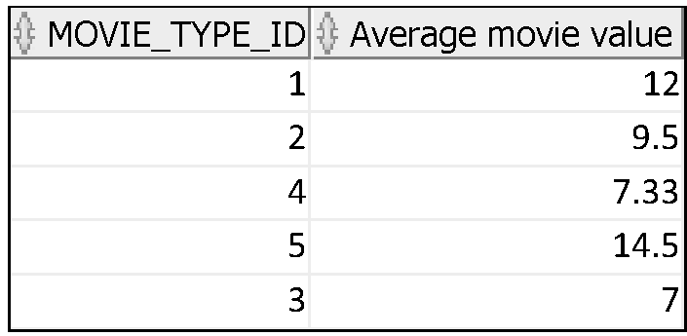
Using the GROUP BY Clause
All columns in the SELECT list that are not in group functions must be in the GROUP BY clause.
select movie_type_id, round(avg(movie_price),2)
as "Average movie value"
from mm_movie
group by movie_type_id;
Notes:
Using the GROUP BY Clause
When using the GROUP BY clause, make sure that all columns in the SELECT list that are not group functions are included in the GROUP BY clause. The example in the slide displays the department number and the average salary for each department. Here is how this SELECT statement, containing a GROUP BY clause, is evaluated:
The SELECT clause specifies the columns to be retrieved, as follows:
movie_type_id column in the mm_movie table
The average value of all movies in the group that you specified in the GROUP BY clause
The FROM clause specifies the tables that the database must access: the MM_MOVIES table.
The WHERE clause specifies the rows to be retrieved. Because there is no WHERE clause, all rows are retrieved by default.
The GROUP BY clause specifies how the rows should be grouped. The rows are grouped by department number, so the AVG function that is applied to the salary column calculates the average movie value for each movie type

Slide 97
Using the GROUP BY Clause
The SELECT clause specifies the columns to be retrieved, as follows:
movie_type_id column in the mm_movie table
The rounded, average value of all movies in the group that you specified in the GROUP BY clause
The FROM clause specifies the tables that the database must access: the MM_MOVIES table.
The WHERE clause specifies the rows to be retrieved. (Because there is no WHERE clause in this example , all rows are retrieved by default. )
select movie_type_id, round(avg(movie_price),2)
as "Average movie value"
from mm_movie
group by movie_type_id;
Notes:
Using the GROUP BY Clause
When using the GROUP BY clause, make sure that all columns in the SELECT list that are not group functions are included in the GROUP BY clause. The example in the slide displays the department number and the average salary for each department. Here is how this SELECT statement, containing a GROUP BY clause, is evaluated:
The SELECT clause specifies the columns to be retrieved, as follows:
movie_type_id column in the mm_movie table
The average value of all movies in the group that you specified in the GROUP BY clause
The FROM clause specifies the tables that the database must access: the MM_MOVIES table.
The WHERE clause specifies the rows to be retrieved. Because there is no WHERE clause, all rows are retrieved by default.
The GROUP BY clause specifies how the rows should be grouped. The rows are grouped by department number, so the AVG function that is applied to the salary column calculates the average movie value for each movie type

Slide 98
Using the GROUP BY Clause
The WHERE clause specifies what GOES INTO the group function
select movie_type_id, round(avg(movie_price),2)
as "Average movie value"
from mm_movie
group by movie_type_id;
Notes:
Using the GROUP BY Clause
When using the GROUP BY clause, make sure that all columns in the SELECT list that are not group functions are included in the GROUP BY clause. The example in the slide displays the department number and the average salary for each department. Here is how this SELECT statement, containing a GROUP BY clause, is evaluated:
The SELECT clause specifies the columns to be retrieved, as follows:
movie_type_id column in the mm_movie table
The average value of all movies in the group that you specified in the GROUP BY clause
The FROM clause specifies the tables that the database must access: the MM_MOVIES table.
The WHERE clause specifies the rows to be retrieved. Because there is no WHERE clause, all rows are retrieved by default.
The GROUP BY clause specifies how the rows should be grouped. The rows are grouped by department number, so the AVG function that is applied to the salary column calculates the average movie value for each movie type

Slide 99
Using the GROUP BY Clause
The GROUP BY clause specifies how the rows should be grouped. The rows are grouped by department number, so the AVG function that is applied to the price column calculates the average movie price for each movie type
When using the GROUP BY clause, make sure that all columns in the SELECT list that are not group functions are included in the GROUP BY clause.
select movie_type_id, round(avg(movie_price),2)
as "Average movie value"
from mm_movie
group by movie_type_id;
Notes:
Using the GROUP BY Clause
When using the GROUP BY clause, make sure that all columns in the SELECT list that are not group functions are included in the GROUP BY clause. The example in the slide displays the department number and the average salary for each department. Here is how this SELECT statement, containing a GROUP BY clause, is evaluated:
The SELECT clause specifies the columns to be retrieved, as follows:
movie_type_id column in the mm_movie table
The average value of all movies in the group that you specified in the GROUP BY clause
The FROM clause specifies the tables that the database must access: the MM_MOVIES table.
The WHERE clause specifies the rows to be retrieved. Because there is no WHERE clause, all rows are retrieved by default.
The GROUP BY clause specifies how the rows should be grouped. The rows are grouped by department number, so the AVG function that is applied to the salary column calculates the average movie value for each movie type

Slide 100
Using the GROUP BY Clause on Multiple Columns
SELECT movie_type_id, movie_cert, round(AVG(movie_price),2)
FROM mm_movie
GROUP BY movie_type_id, movie_cert;
You can return summary results for groups and subgroups by listing more than one GROUP BY column.
You can determine the default sort order of the results by the order of the columns in the GROUP BY clause.
Notes:
Groups Within Groups (continued)
You can return summary results for groups and subgroups by listing more than one GROUP BY column. You can determine the default sort order of the results by the order of the columns in the GROUP BY clause. In the slide example, the SELECT statement containing a GROUP BY clause is evaluated as follows:
The SELECT clause specifies the column to be retrieved:
Department number in the EMPLOYEES table
Job ID in the EMPLOYEES table
The sum of all the salaries in the group that you specified in the GROUP BY clause
The FROM clause specifies the tables that the database must access: the EMPLOYEES table.
The GROUP BY clause specifies how you must group the rows:
First, the rows are grouped by department number.
Second, the rows are grouped by job ID in the department number groups.
So the SUM function is applied to the salary column for all job IDs in each department number group.

Slide 101
Using the GROUP BY Clause on Multiple Columns
SELECT movie_type_id, movie_cert, round(AVG(movie_price),2)
FROM mm_movie
GROUP BY movie_type_id, movie_cert;
The SELECT statement containing a GROUP BY clause is evaluated as follows:
The SELECT clause specifies the column to be retrieved:
Movie_type_id in the MM_MOVIE table
Movie_cert in the MM_MOVIE table
The average of all prices in the group that you specified in the GROUP BY clause
The FROM clause specifies the tables that the database must access: the MM_MOVIE table.
The GROUP BY clause specifies how you must group the rows:
First, the rows are grouped by movie_cert
Second, the rows are grouped by movie_cert in the movie_type_id groups.
So the AVG function is applied to the price column for all movie_certs in each movie_type_Id group.
Notes:
Groups Within Groups (continued)
You can return summary results for groups and subgroups by listing more than one GROUP BY column. You can determine the default sort order of the results by the order of the columns in the GROUP BY clause. In the slide example, the SELECT statement containing a GROUP BY clause is evaluated as follows:
The SELECT clause specifies the column to be retrieved:
Department number in the EMPLOYEES table
Job ID in the EMPLOYEES table
The sum of all the salaries in the group that you specified in the GROUP BY clause
The FROM clause specifies the tables that the database must access: the EMPLOYEES table.
The GROUP BY clause specifies how you must group the rows:
First, the rows are grouped by department number.
Second, the rows are grouped by job ID in the department number groups.
So the SUM function is applied to the salary column for all job IDs in each department number group.

Slide 102
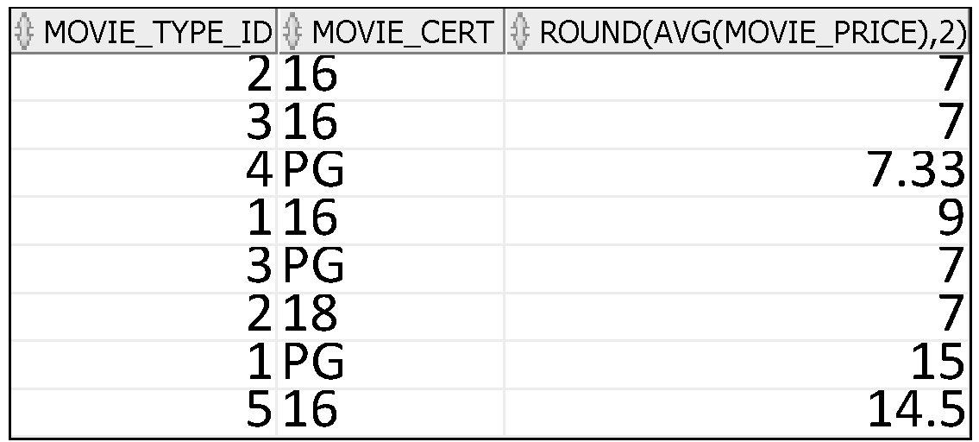
Using the GROUP BY Clause on Multiple Columns
SELECT movie_type_id, movie_cert, round(AVG(movie_price),2)
FROM mm_movie
GROUP BY movie_type_id, movie_cert;
Notes:
Groups Within Groups (continued)
You can return summary results for groups and subgroups by listing more than one GROUP BY column. You can determine the default sort order of the results by the order of the columns in the GROUP BY clause. In the slide example, the SELECT statement containing a GROUP BY clause is evaluated as follows:
The SELECT clause specifies the column to be retrieved:
Department number in the EMPLOYEES table
Job ID in the EMPLOYEES table
The sum of all the salaries in the group that you specified in the GROUP BY clause
The FROM clause specifies the tables that the database must access: the EMPLOYEES table.
The GROUP BY clause specifies how you must group the rows:
First, the rows are grouped by department number.
Second, the rows are grouped by job ID in the department number groups.
So the SUM function is applied to the salary column for all job IDs in each department number group.

Slide 103
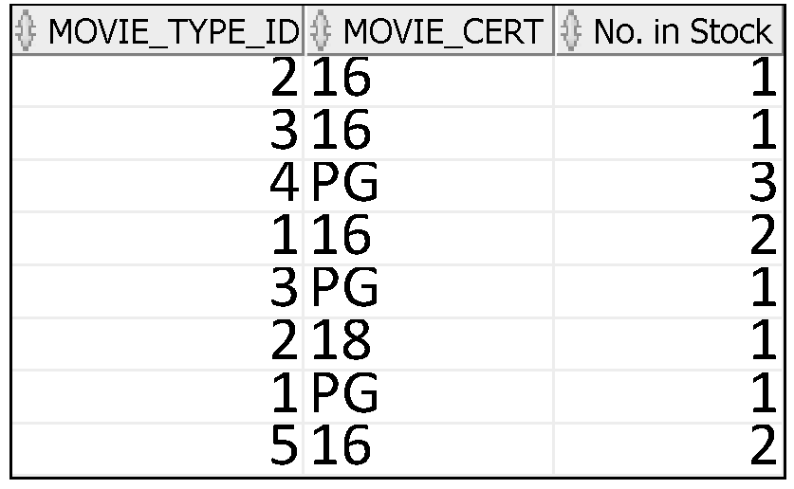
Using the GROUP BY Clause on Multiple Columns
SELECT movie_type_id, movie_cert,
count(movie_id) "No. in Stock"
FROM mm_movie
GROUP BY movie_type_id, movie_cert;
Notes:
Groups Within Groups (continued)
You can return summary results for groups and subgroups by listing more than one GROUP BY column. You can determine the default sort order of the results by the order of the columns in the GROUP BY clause. In the slide example, the SELECT statement containing a GROUP BY clause is evaluated as follows:
The SELECT clause specifies the column to be retrieved:
Department number in the EMPLOYEES table
Job ID in the EMPLOYEES table
The sum of all the salaries in the group that you specified in the GROUP BY clause
The FROM clause specifies the tables that the database must access: the EMPLOYEES table.
The GROUP BY clause specifies how you must group the rows:
First, the rows are grouped by department number.
Second, the rows are grouped by job ID in the department number groups.
So the SUM function is applied to the salary column for all job IDs in each department number group.

Slide 104
WHERE AND HAVING
Use where to restrict what GOES INTO the group function
Use HAVING to restrict the groups that are output

Slide 105
Restricting Group Results with the HAVING Clause
When you use the HAVING clause, the Oracle server restricts groups as follows:
1. Rows are grouped by the expression you have given.
2. The group function is applied.
3. Groups matching the HAVING clause are displayed.
SELECT column, group_function
FROM table
[WHERE condition]
[GROUP BY group_by_expression]
[HAVING group_condition]
[ORDER BY column];
Notes:
Restricting Group Results with the HAVING Clause
You use the HAVING clause to specify which groups are to be displayed, thus further restricting the groups on the basis of aggregate information.
In the syntax, group_condition restricts the groups of rows returned to those groups for which the specified condition is true.
The Oracle server performs the following steps when you use the HAVING clause:
1. Rows are grouped.
2. The group function is applied to the group.
3. The groups that match the criteria in the HAVING clause are displayed.
The HAVING clause can precede the GROUP BY clause, but it is recommended that you place the GROUP BY clause first because that is more logical. Groups are formed and group functions are calculated before the HAVING clause is applied to the groups in the SELECT list.

Slide 106
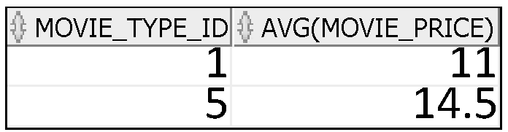
Using the HAVING Clause
SELECT movie_type_id, AVG(movie_price)
FROM mm_movie
GROUP BY movie_type_id
HAVING AVG(movie_price) > 8;
Notes:
Using the HAVING Clause
The slide example displays department numbers and maximum salaries for those departments with a maximum salary that is greater than $10,000.
You can use the GROUP BY clause without using a group function in the SELECT list.
If you restrict rows based on the result of a group function, you must have a GROUP BY clause as well as the HAVING clause.
The following example displays the department numbers and average salaries for those departments with a maximum salary that is greater than $10,000:
SELECT department_id, AVG(salary)
FROM employees
GROUP BY department_id
HAVING max(salary)>10000;

Slide 107
Things to be able to explain/Be able to do
Groups
Know the syntax
Explain the principles
Be able to explain what the WHERE clause does
Be able to explain the HAVING clause
Be able to develop SQL to achieve it
Be able to use with inner/outer joins
Recognise the output of a query

Slide 108
Views

Slide 109
VIEWS
A database view is a logical or virtual table based on a query.
It is useful to think of a view as a stored query.
They are useful ways of presenting different information to different users.
Views
are created through use of a CREATE VIEW command that incorporates use of the SELECT statement.
are queried just like tables.

Slide 110
Defining Views
Suppose we have the following table:
Employee(PRSINO, name, department, project, salary)
Our HR department has permission to view information about all employees but the manager of the IT department only has permission to view the name of their staff and the name of the project on which they are currently working
We can create a view for the IT manager
CREATE VIEW IT AS
SELECT name, project
FROM Employee
WHERE department = ‘IT’;

Slide 111
Things to be able to explain/Be able to do
View
Know the syntax to create
Explain the principles
Be able to develop SQL to achieve it

Slide 112
Set Operations

Slide 113
Set Operators
A
B
A
B
UNION/UNION ALL
A
B
INTERSECT
A
B
MINUS
Notes:
Set Operators
The set operators combine the results of two or more component queries into one result. Queries containing set operators are called compound queries.
All set operators have equal precedence. If a SQL statement contains multiple set operators, the Oracle server evaluates them from left (top) to right (bottom) if no parentheses explicitly specify another order. You should use parentheses to specify the order of evaluation explicitly in queries that use the INTERSECT operator with other set operators.

Slide 114

Using the UNION Operator
Display the current and previous job details of all employees. Display each employee only once.
SELECT employee_id, job_id
FROM employees
UNION
SELECT employee_id, job_id
FROM job_history;
…
…
Notes:
Using the UNION Operator
The UNION operator eliminates any duplicate records. If records that occur in both the EMPLOYEES and the JOB_HISTORY tables are identical, the records are displayed only once. Observe in the output shown on the slide that the record for the employee with the EMPLOYEE_ID 200 appears twice because the JOB_ID is different in each row.
Consider the following example:
SELECT employee_id, job_id, department_id
FROM employees
UNION
SELECT employee_id, job_id, department_id
FROM job_history;
Using the UNION Operator (continued)
In the preceding output, employee 200 appears three times. Why? Notice the DEPARTMENT_ID values for employee 200. One row has a DEPARTMENT_ID of 90, another 10, and the third 90. Because of these unique combinations of job IDs and department IDs, each row for employee 200 is unique and therefore not considered to be a duplicate. Observe that the output is sorted in ascending order of the first column of the SELECT clause (in this case, EMPLOYEE_ID).

Slide 115

Using the UNION ALL Operator
Display the current and previous departments of all employees.
SELECT employee_id, job_id, department_id
FROM employees
UNION ALL
SELECT employee_id, job_id, department_id
FROM job_history
ORDER BY employee_id;
…
…
Notes:
UNION ALL Operator (continued)
In the example, 30 rows are selected. The combination of the two tables totals to 30 rows. The UNION ALL operator does not eliminate duplicate rows. UNION returns all distinct rows selected by either query. UNION ALL returns all rows selected by either query, including all duplicates. Consider the query on the slide, now written with the UNION clause:
SELECT employee_id, job_id,department_id FROM employees UNION SELECT employee_id, job_id,department_id FROM job_history ORDER BY employee_id;
The preceding query returns 29 rows. This is because it eliminates the following row (as it is a duplicate):

Slide 116

Using the INTERSECT Operator
Display the employee IDs and job IDs of those employees who currently have a job title that is the same as their job title when they were initially hired (that is, they changed jobs but have now gone back to doing their original job).
SELECT employee_id, job_id
FROM employees
INTERSECT
SELECT employee_id, job_id
FROM job_history;
Notes:
INTERSECT Operator (continued)
In the example in this slide, the query returns only the records that have the same values in the selected columns in both tables.
What will be the results if you add the DEPARTMENT_ID column to the SELECT statement from the EMPLOYEES table and add the DEPARTMENT_ID column to the SELECT statement from the JOB_HISTORY table and run this query? The results may be different because of the introduction of another column whose values may or may not be duplicates.
Example
SELECT employee_id, job_id, department_id
FROM employees
INTERSECT
SELECT employee_id, job_id, department_id
FROM job_history;
Employee 200 is no longer part of the results because the EMPLOYEES.DEPARTMENT_ID value is different from the JOB_HISTORY.DEPARTMENT_ID value.

Slide 117
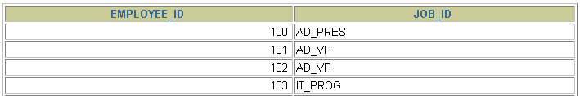

MINUS Operator
Display the employee IDs of those employees who have not changed their jobs even once.
SELECT employee_id,job_id
FROM employees
MINUS
SELECT employee_id,job_id
FROM job_history;
…
Notes:
MINUS Operator (continued)
In the example in the slide, the employee IDs and job IDs in the JOB_HISTORY table are subtracted from those in the EMPLOYEES table. The results set displays the employees remaining after the subtraction; they are represented by rows that exist in the EMPLOYEES table but do not exist in the JOB_HISTORY table. These are the records of the employees who have not changed their jobs even once.

Slide 118
Set Operator Guidelines
The expressions in the SELECT lists must match in number and data type.
Parentheses can be used to alter the sequence of execution.
The ORDER BY clause:
Can appear only at the very end of the statement
Will accept the column name, aliases from the first SELECT statement, or the positional notation
Notes:
Set Operator Guidelines
The expressions in the select lists of the queries must match in number and data type. Queries that use UNION, UNION ALL, INTERSECT, and MINUS operators in their WHERE clause must have the same number and type of columns in their SELECT list. For example:
SELECT employee_id, department_id
FROM employees
WHERE (employee_id, department_id)
IN (SELECT employee_id, department_id
FROM employees
UNION
SELECT employee_id, department_id
FROM job_history);
The ORDER BY clause:
Can appear only at the very end of the statement
Will accept the column name, an alias, or the positional notation
The column name or alias, if used in an ORDER BY clause, must be from the first SELECT list.
Set operators can be used in subqueries.

Slide 119
The Oracle Server and Set Operators
Duplicate rows are automatically eliminated except in UNION ALL.
Column names from the first query appear in the result.
The output is sorted in ascending order by default except in UNION ALL.
Notes:
The Oracle Server and Set Operators
When a query uses set operators, the Oracle server eliminates duplicate rows automatically except in the case of the UNION ALL operator. The column names in the output are decided by the column list in the first SELECT statement. By default, the output is sorted in ascending order of the first column of the SELECT clause.
The corresponding expressions in the select lists of the component queries of a compound query must match in number and data type. If component queries select character data, the data type of the return values is determined as follows:
If both queries select values of data type CHAR, the returned values have data type CHAR.
If either or both of the queries select values of data type VARCHAR2, the returned values have data type VARCHAR2.

Slide 120
Thinks to Know/Be able to do
Know the syntax
Explain the principles
Be able to develop SQL to achieve a set operation
Recognise the output of a query

Slide 121
Transactions

Slide 122
Transactions and SQL
Transaction
Series of action queries that represent a logical unit of work
User can commit (save) changes
User can roll back (discard) changes
Pending transaction
A transaction waiting to be committed or rolled back
Oracle DBMS locks records associated with pending transactions
Other users cannot view or modify locked records

Slide 123
Transactions and SQL
The SELECT statement reads data from the database
BUT doesn’t change anything.
The other three DML statements DO change the data.
Because they change the data, the DBMS (Database Management System) goes into defensive mode.
It LOCKS all rows that are subjected to
INSERT
UPDATE
DELETE
This means other users of the database cannot make changes to this data until the statements are complete.

Slide 124
Transactions in SQL
As soon as Oracle sees an INSERT, UPDATE or DELETE, it starts a TRANSACTION
The transaction continues until the operations are either COMMITed or ROLLed BACK
COMMIT
This makes all of the operations permanent
ROLLBACK
This is like ‘undo’. It rolls back all operations carried out by the current session since the last COMMIT

Slide 125
Data Definition Language
Any DDL statement performs a COMMIT
A DDL statement is a Data Definition Language statement, such as CREATE, ALTER or DROP

Slide 126
Database Transaction
A database transaction consists of one of the following:
DML statements which constitute one consistent change to the data
One DDL statement
One DCL (Data Control Language) statement

Slide 127
The Transaction Control Commands
Commit makes all changes since the beginning of a transaction permanent
Rollback rolls back (undoes) all changes since the beginning of a transaction
Other users cannot see the results of the transaction until it has been committed.

Slide 128
Data Concurrency and Consistency
Data concurrency
Means that many users can access data at the same time.
Data consistency
Means that each user sees a consistent view of the data, including visible changes made by the user’s own transactions and transactions of other users.

Slide 129
Advantages of COMMIT and ROLLBACK
With COMMIT and ROLLBACK statements, you can:
Ensure data consistency
Preview data changes before making changes permanent
Group logically related operations

Slide 130
State of the Data Before COMMIT or ROLLBACK
The previous state of the data can be recovered.
The current user can review the results of the DML operations by using the SELECT statement.
Other users can not view the results of the DML statements by the current user.
The affected rows are locked
Other users cannot change the data within the affected rows.

Slide 131
State of the Data after COMMIT
Data changes are made permanent in the database.
The previous state of the data is permanently lost.
All users can view the results.
Locks on the affected rows are released; those rows are available for other users to manipulate.
All savepoints are erased.

Slide 132
Data Definition Language
Any DDL statement performs a COMMIT
A DDL statement is a Data Definition Language statement, such as CREATE, ALTER or DROP

Slide 133
Things to be able to explain/Be able to do
What is a transaction?
Why is it needed?
Commit and Rollback? When to use? What do they achieve?

Slide 134
Exam Paper

Slide 135
Sample Papers
Sample of new format will be posted later this week
Past papers are available from the left-hand menu

Slide 136
Tackling the Exam Paper
Section A (Compulsory)
Question 1 60 marks
Question 2 20 marks
Section B (Choose one question)
Question 3 20 marks
Question 4 20 marks

Slide 137
Tackling the Exam Paper
All Questions in Section A (Compulsory)
Choose one question from Section B
Time allowed 2 hrs = 120 mins
Heuristic
Spend as many minutes answering a question as there are marks allocated to the question in total
Use the rest of the time wisely
5-10 mins at start READ THE QUESTIONS
Make notes
When you start a question
READ IT AGAIN
Pay special attention to anything in italics or bold
Leave 5-10 mins at the end
Finish off anything you left
READ THE QUESTIONS AGAIN
Review your answers

Slide 138
Section A Compulsory
Q1 (60 marks) and Q 2 (20 marks)

Slide 139
Section B Choose One Question
Question 3 (20 marks), Question 4 (20 marks)

